Slide 1
Tableau Desktop Training v. 2020.3

Slide 2
Class Agenda
Introduction to Desktop
Desktop Workflow
Connecting/Modifying Data Sources
Filters and Sorting
Creating Groups and Hierarchies
Understanding Dates
Using Multiple Measures in a View
Text Tables and Alternatives
Creating Scatter Plots
Creating Calculations
Analyzing Data with Quick Table Calculations
Highlighting Data with Reference Lines
Showing Parts of the Whole
Creating and Using Parameters
Mapping Data Geographically
Dashboards
Publishing to Tableau Server

Slide 3
How to Use the Class Materials
Practices
High-level goals and image
Direction steps
Student Materials folder
Data folder, with data sources for reference
Workbooks folder, with starter and solution .twbx files (plus sample .twbx files)
Conducted in Class/Homework
Some practice time in class, some assigned after we discuss topic at end of session
Recommended to revisit Tableau at some point between sessions

Slide 4
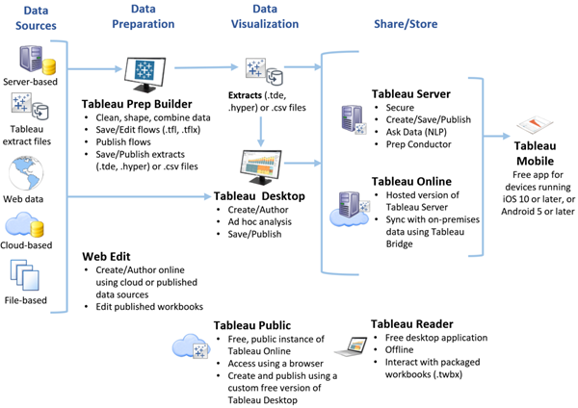
Tableau Platform

Slide 5
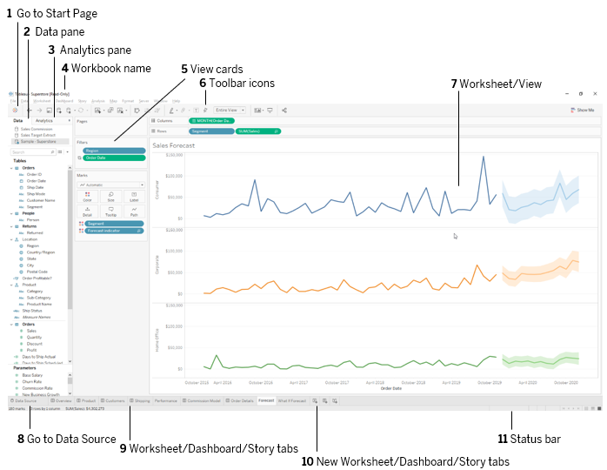
Application Terminology

Slide 6
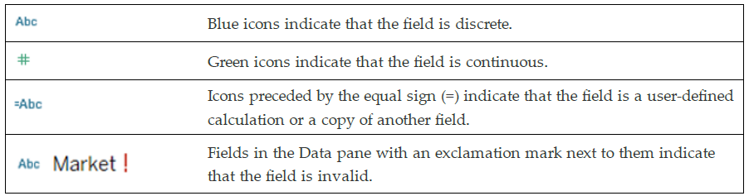
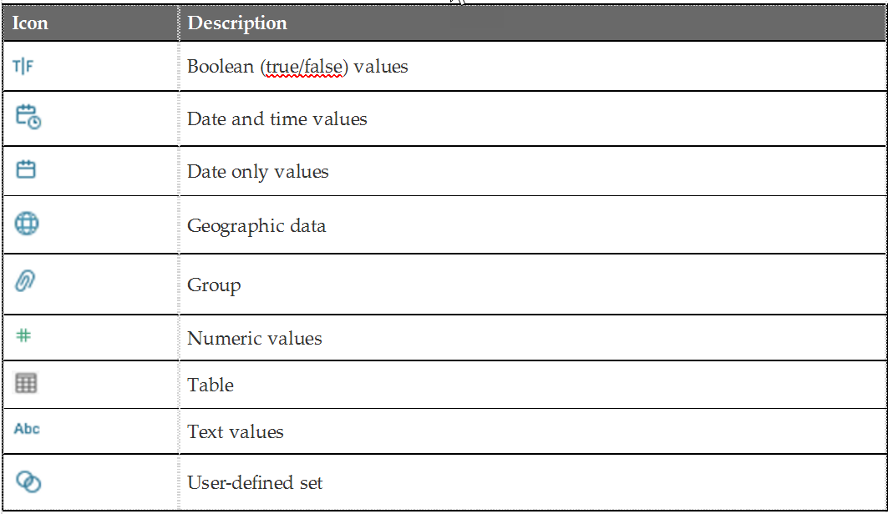
Visual Cues for Fields
Modifiers
Fields in the Data Pane

Slide 7
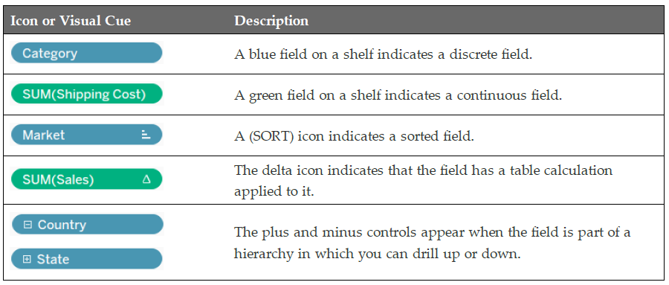
Visual Cues for Fields
Fields on Shelves

Slide 8
Understanding the Desktop Workflow
Workflow step | Description
Connect | On the Start page, you can connect to nearly any database or text file available.
Analyze | Use dimension fields and measure fields to build the visualizations that allow you to see your data.
Share | Build a dashboard or a story you can share with others, or for your deeper data exploration.
As you become an advanced user, your workflow becomes less linear and more iterative.

Slide 9
Elements of a Visualization
Use Show Me to get a recommendation for a view.
—or—
Drag fields to Columns, Rows and the Marks card to build your own.
For most of the views in this course, you will build your own.

Slide 10
Getting Started: Data Pane
Component | Description
Dimensions | Fields that contain qualitative, categorical data such as text and dates. Dimensions typically set the level of aggregation for numeric data, and create labels in a view.
Measures | Fields that contain numbers that can be aggregated. Measures typically create numerical axes in a view.
Parameters | Dynamic variables that can replace constant values, and which allow view consumers to control the view in some way.
Sets | Subsets of data that you define.

Slide 11
Getting Started: Analytics Pane
Component | Description
Summarize | Includes options to add pre-defined components such as constant and average lines, medians with quartiles, box plots, and totals.
Model | Adds modeling information to your view, such as trend lines, forecasting, and average distribution bands.
Custom | Add custom lines, bands, and box plots.

Slide 12
Getting Started: View Components
Component | Description
Columns and Rows | Drag dimension and measure fields to these shelves to define how you want the data shown in the view.
Pages | Show data changes over time or across discrete dimensions.
Filter | Use filters to limit the data shown. Use on a dashboard to allow others to control how the data is displayed in the visualization.
Marks | Data as shown in the visualization. Bars, circles, pies, text, and lines are examples of marks.
Marks card | Use to change the appearance of "mark" types.
Worksheets | Tabs across the bottom of the view correspond to the worksheets contained within the workbook.

Slide 13
Quick Tableau Demo

Slide 14
Setting Up Connections and Data Sources

Slide 15
Tableau File Types and Extensions
File Type and Extension | Description
Tableau Workbooks (.twb) | Contain one or more worksheets and dashboards and always refer to data outside of the workbook itself.
Tableau Packaged Workbooks (.twbx) | Contain a workbook along with any supporting local file data sources and background images. This format is the best way to package your work for sharing with others who don’t have access to the data.
Tableau Bookmark (.tbm) files | Contain a single worksheet and are an easy way to quickly share work between workbooks.
Tableau Data Extract files (.hyper or legacy .tde) | Local copy of an entire data source or a subset that you can use to share data or work offline.
Tableau Data Connection (.tds) files | Shortcuts for data sources used often. Contain just the information you need to connect to the data sources such as data source type, location, and custom fields.

Slide 16
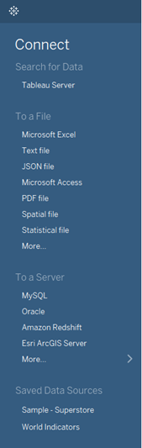
Creating a Live Data Connection
Types of connections
Connect to a file
Connect to a server
Connect to a saved data source

Slide 17
Saving and Editing a Data Source
Tableau Data Source (.tds) file contains:
Modifications you've made to a data source, such as changing default properties or renaming a field (but not the data itself),
Parameters, calculated fields, groups, hierarchies, bins, or sets you've created.
Saving options:
Locally for personal use:
Changes to data source are not inherited.
Exported to Tableau Server for work group sharing:
Subsequent workbooks can inherit data source changes.

Slide 18
Modifying Data Attributes
Examples:
Organize dimensions and measures with folders.
Change a measure to a dimension, or a dimension to a measure.
Set the default properties for a measure:
Comment
Color
Number Format
Aggregation
Totals
Set the default properties for a dimension:
Comment
Color
Shape
Sort

Slide 19
Sharing a Data Source
If you have Tableau Server, you can share a data source connection (.tds) file with other users.
Save locally for personal use.
Create a local copy for editing from a shared file on Tableau Server.
Publish to Tableau Server for work group sharing.

Slide 20
Understanding Changes to Data
Impact of data connection type:
Live—changes reflected immediately
Extracts—changes require a refresh
Impact of type of data change:
Changes to data values will be reflected
Structural changes (such as removing columns or changing the data type or name) may break the visualization

Slide 21
Practice: Creating a Local Data Connection p.2

Slide 22
Filters and Sorting

Slide 23
Data Filtering
Narrows the data shown in a view to focus on relevant information
Filters shelf shows which filters are in use
Options vary by field type (dimension, measure, date)
Filter appearance and behavior

Slide 24
Filter on a Dimension
Filter Option | Description
General | Shows members of the dimensions you can select for inclusion or exclusion.
Wildcard | Sets up a wildcard inclusion or exclusion of members matching the value entered.
Condition | Filters values based on specific conditions. Can be determined by fields, range of values, or formula.
Top | Filter by top (or bottom) “N” when N is determined by the value of specified fields or by formula (for example, Top 10 Cities by Profit).

Slide 25
Filter on a Measure
Filter Option | Description
Range of Values | Include all values within the specified range
At Least | Include all values above a specified value
At Most | Include all values below a specified value
Special | Set filter for null or non-null values

Slide 26
Practice: Filters - Individually p. 4

Slide 27
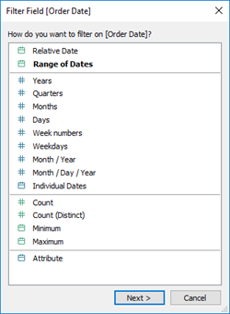
Creating Date Filters
Relative date filters
Update data dynamically with time
Example: 3 months before or after the current date
Range of dates
Specify a definite span of time
Define starting or ending dates
Specific date field values
Examples: years, weekdays

Slide 28
Computed Sorts
Organize data by applying rules
Examples: alphabetical, ascending/descending order
Change dynamically as data changes
Can be set as a default for a dimension

Slide 29
Manual Sorts
Organize data in a fixed order
Example: show a particular region first
Do not change dynamically (maintained even when data changes)
Can be set as a default for a dimension

Slide 30
Practice: Sorting - Together p. 6

Slide 31
Using Groups and Hierarchies

Slide 32
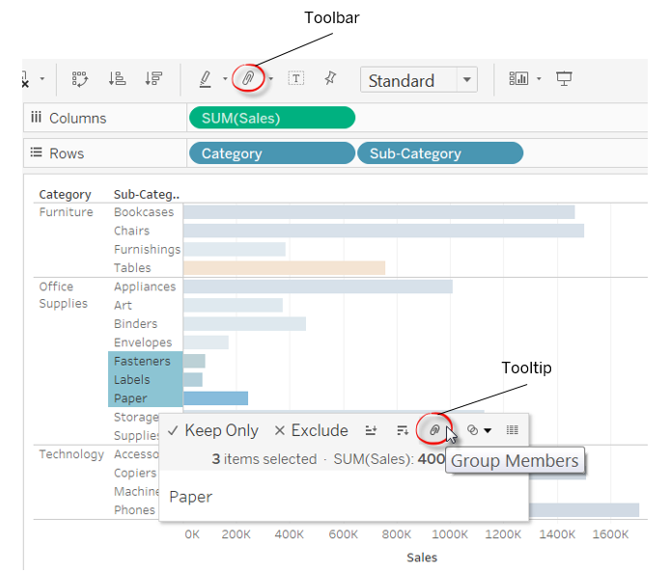
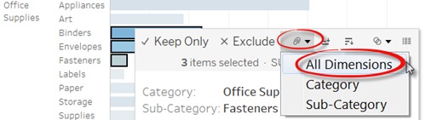
Using Groups
A group is a set of dimension members combined into higher level categories
Example: states grouped as a region or similar products grouped as a category
Methods to create groups:
From the view by selecting dimension labels and using the group icon or menu
From the data pane
Visually by selecting marks

Slide 33
Creating and Using Hierarchies
Use hierarchies to organize data from general to specific
Example: country > region > state > postal code
Use when data does not contain logical levels of aggregation.
Click the plus (+) sign and drill into the data with the path defined by the hierarchy.
Reorder fields in the hierarchy by dragging and dropping.

Slide 34
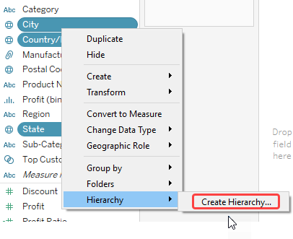
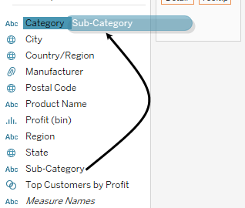
Creating and Using Hierarchies (continued)
Two Ways to Build
Drag and drop
Context (right-click) menu

Slide 35
Practice: Creating Groups and Hierarchies p. 8 - Individually

Slide 36
Using Dates

Slide 37
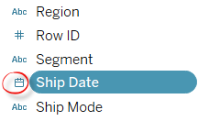
Working with Dates
Dates are automatically placed in the dimensions area of the data pane:
Date/time fields are identified by the calendar icon.
Automatic hierarchy is created for dates:
Begins at the highest level in the data, usually year.
Right-click on the field to change the hierarchy.
Date hierarchies and attributes in OLAP (or cubes) are defined when the cube is created:
They cannot be modified in Tableau.
The standard Gregorian calendar is used by default:
The ISO-8601 week-based calendar can be selected for any data source.

Slide 38
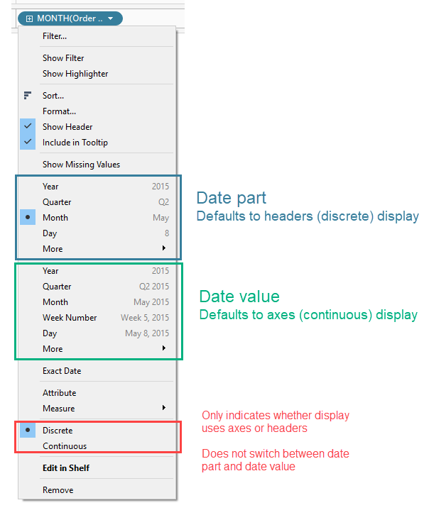
Discrete Date Parts and Continuous Date Values
Discrete dates are organized as discrete
date parts, independent of linear time
Organized by date units, such as aggregated data for all Novembers over several years.
Continuous date values represent the chronological progression of time
Create an axis as a timeline.

Slide 39
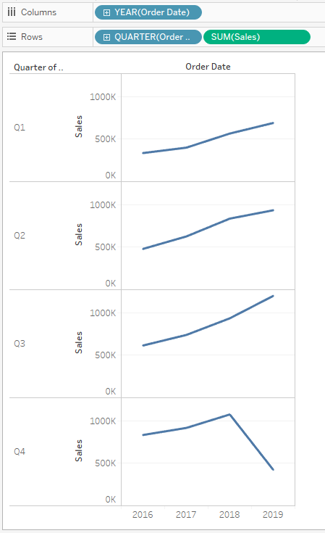
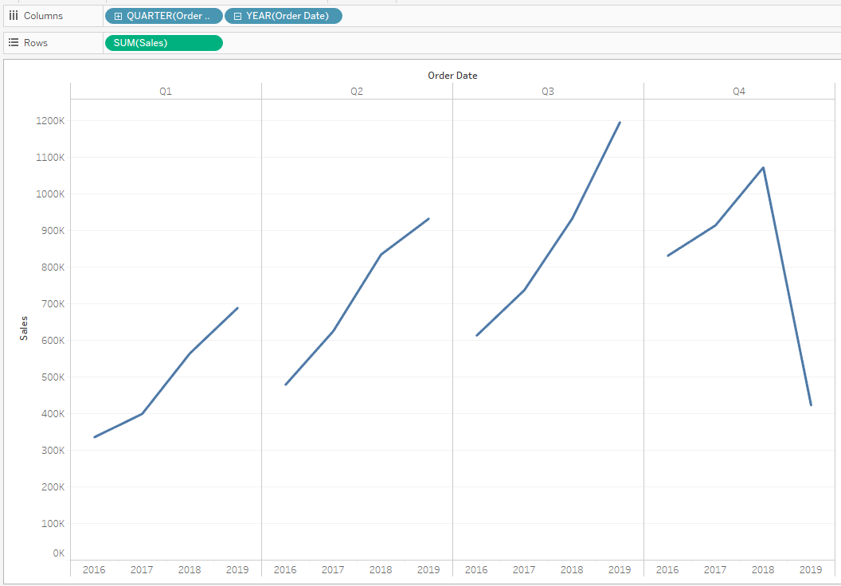
Using Discrete Date Parts
Reorder date hierarchy:
Place quarter before year
Place date parts on different shelves:
Year on columns
Quarter on rows

Slide 40
Practice: Date Parts and Date Values p. 9 - Individually

Slide 41
Creating Custom Dates
Custom dates are calculated date parts that you can save.
Example: reuse the custom date part or value without having to override the default behavior for each use.
Can be used to "break" the automatic date hierarchy or to create elements to use in defining a new one.
Example: new dimension for just the month of order data
Allow for each field to represent just itself.
Can be continuous date values or discrete date parts.

Slide 42
Practice: Using Custom Dates p. 11 Together or After Class

Slide 43
Creating Date Filters
Relative date filters
Update data dynamically with time
Example: 3 months before or after the current date
Range of dates
Specify a definite span of time
Define starting or ending dates
Specific date field values
Examples: years, weekdays

Slide 44
Using Multiple Measures in a View

Slide 45
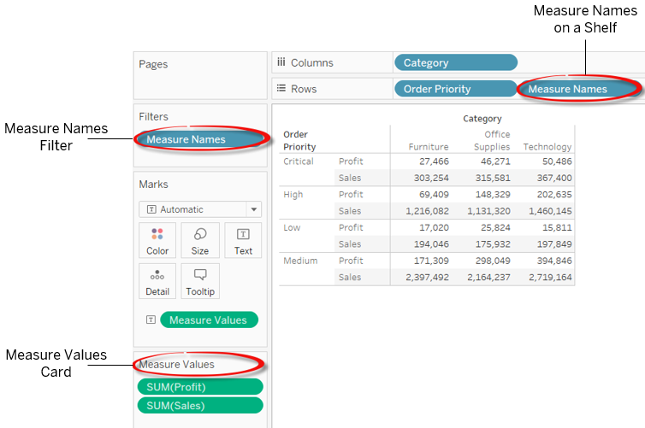
Measure Values and Measure Names
Tableau-generated fields that serve as containers for more than one measure:
Measure Names—at the bottom of the dimensions list
Measure Values—at the bottom of the measures list
Appear automatically when you create a combined (shared) axis or dual axis chart.

Slide 46
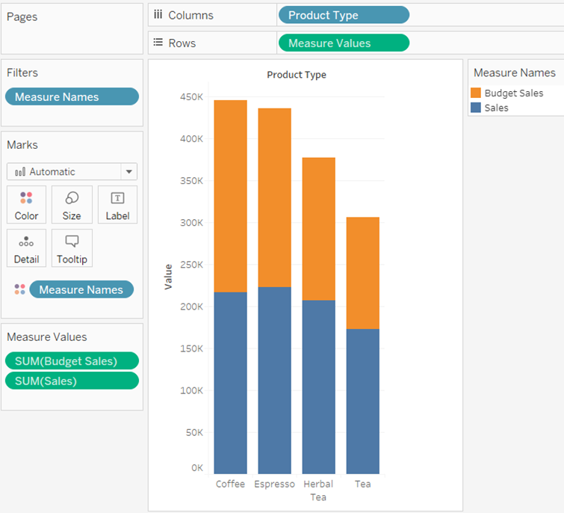
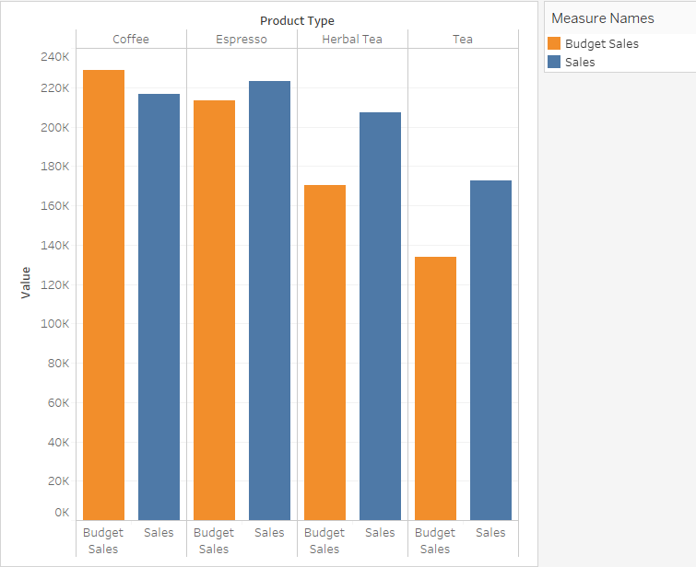
Combined or Shared Axis Charts
More than one measure on the same axis
Use for comparing multiple measures in a single view.
Highlight the relationship between the two measures.
Drag the second measure to the existing axis.
Show marks side-by-side or stacked.

Slide 47
Practice: Combined Axis Chart p. 14

Slide 48
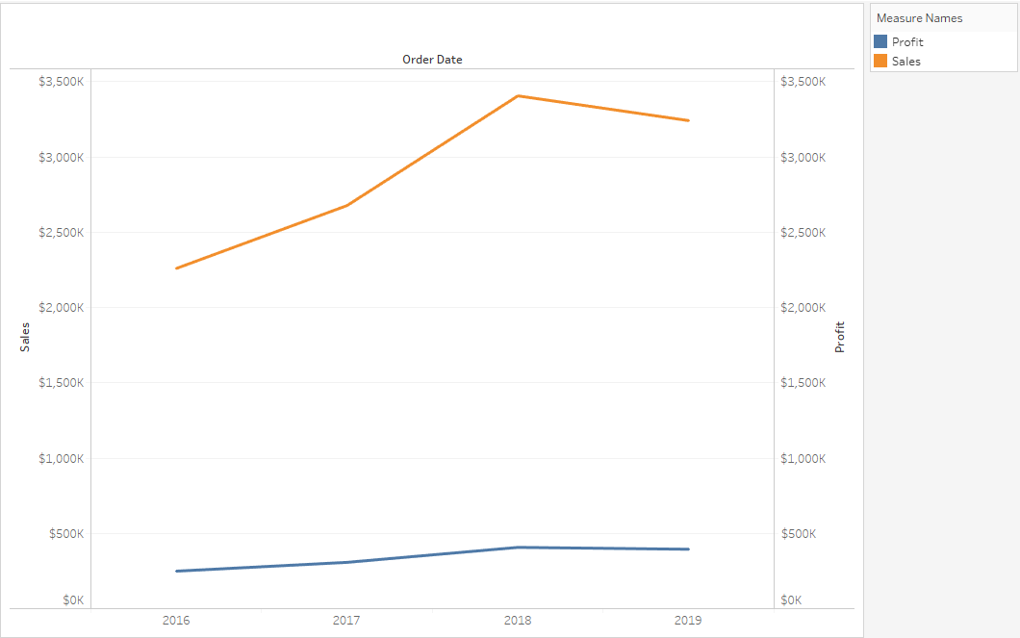
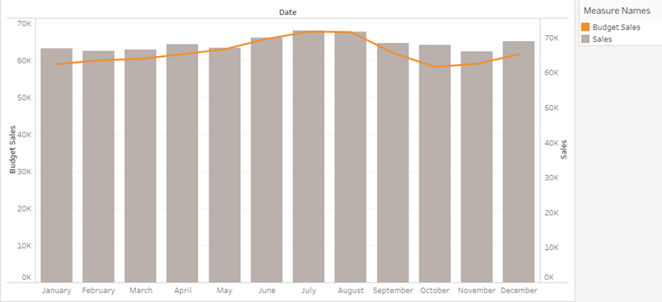
Creating Dual Axis Charts
Useful for showing how two different measures compare
Different measurement units (for example, dollars and number of days)
Same unit of measure, but on two different scales
Can be shown with different mark types

Slide 49
Practice: Dual Axis Chart p. 15

Slide 50
Text Tables and Alternatives

Slide 51
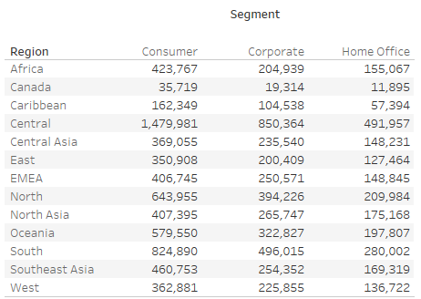
Creating Crosstabs
Use when specific numeric values need to be represented in the view.
To create:
One dimension on columns
One dimension on rows
One measure to text on the Marks card
From an existing view:
Right-click the tab for the worksheet you want to use, and choose Duplicate as Crosstab.

Slide 52
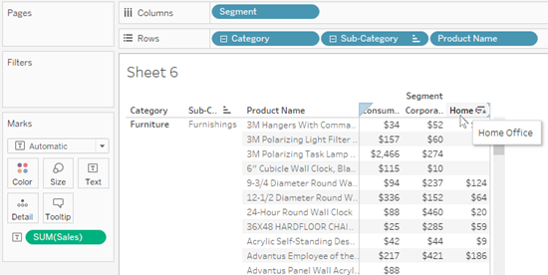
Creating Crosstabs (cont'd)
Sort your table column:
Nested or Field sort columns containing a single value per pane, or columns having discrete measures.
To create:
One dimension to Columns
Several dimensions to Rows
One measure to text on the Marks card
On Rows, right-click a dimension and choose Sort.
In the dialog box, choose Field, Ascending, Field Name, Sales and Sum.

Slide 53
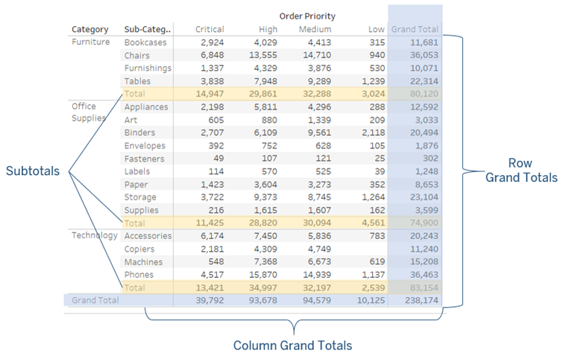
Grand Totals, Subtotals, and Changing Aggregations
Add row and column grand totals and subtotals to help users interpret data.
Change the display positions as needed.
Use additional formatting for emphasis.
Adjust the aggregation.

Slide 54
Practice: Creating a Crosstab with Totals p. 16

Slide 55
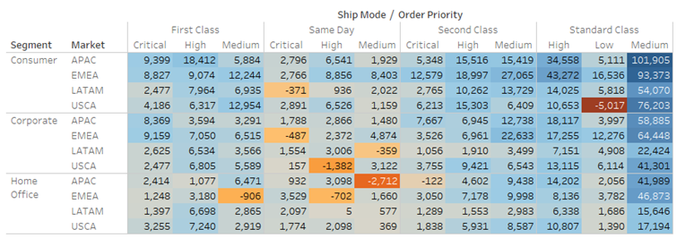
Creating Highlight Tables
A color-encoded crosstab that calls attention to very high or low data values:
Show detailed values in text.
Emphasize outliers in color.
Include totals, color-encoded or not, as desired.

Slide 56
Practice: Highlight Tables p. 17

Slide 57
Practice: Heat Maps p. 18

Slide 58
Scatterplots

Slide 59
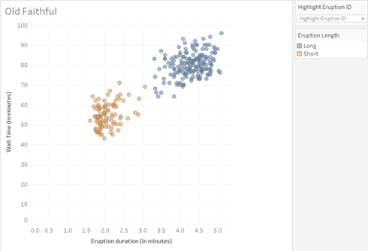
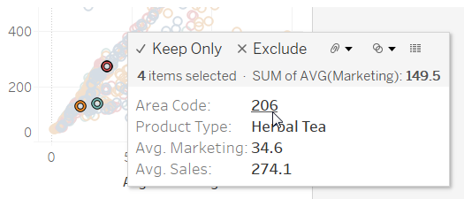
Showing Correlations and Outliers with Scatter Plots
A graph of plotted points to compare two measures and to show patterns across data sets.
Scatter plots can:
Answer questions about relationships between variables (correlations).
Visualize data that deviates from the primary trend (outliers).
Highlighters and/or tooltip selections are useful for analysis. Explain Data can also be used.

Slide 60
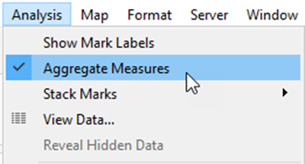
Create a Scatter Plot
Compare two measures on opposite (x and y) axes, or on rows and columns.
Use dimensions to see how the measures compare when sliced differently.
Disaggregate the measures to see all records in the data set.
Click to disaggregate

Slide 61
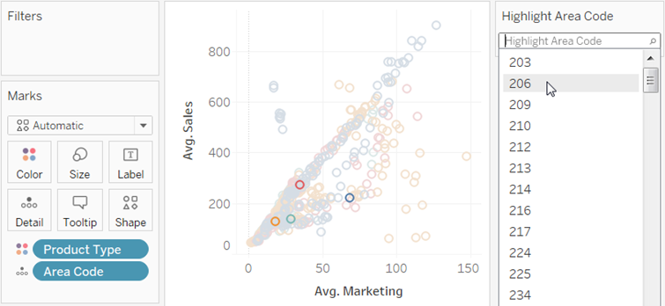
Analyze Using the Highlighter
Use the highlighter to perform ad-hoc analysis of the data in scatter plots:
Use a discrete field (dimension) that is included in the view and impacts the level of detail in the view.
Right-click the field on the Marks card, and then click Show Highlighter.

Slide 62
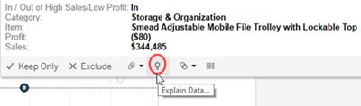
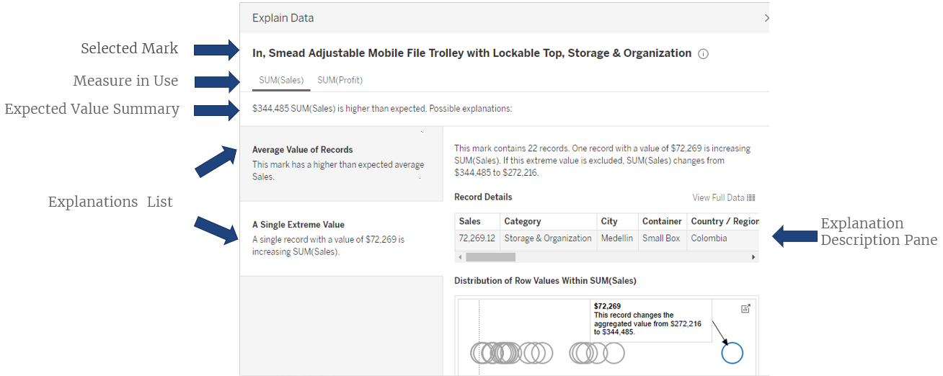
Analyze Using Explain Data
Select a mark and run Explain Data
View results in the Explain Data Window:

Slide 63
Practice: Creating a Scatter Plot p. 19

Slide 64
Calculations

Slide 65
Using Calculated Fields in Desktop
Use when your underlying data does not contain all of the values you need for your analysis.
A calculation can include some of all of these components:
Component | Description
Fields | Contains all data source fields and calculated fields.
Functions | Functions you can use to create a formula, which are available from the drop-down menu, organized into categories.
Operators | Operators must be typed manually. Use standard operators, such as addition (+), subtraction (–), multiplication (*), modulo (%) and division (/) as well as comparisons (==,=,>,<,>=,<=,!=,<>), and logical (AND, OR, NOT).
Parameters | Placeholder variables that can be inserted into calculations to replace constant values.
Comments | Insert custom comments for your calculations as a means of annotation for later review. To add a comment to a calculation, type two forward slash characters (//) into the formula pane.

Slide 66
Calculation Types
Calculation | Description
Calculated Fields | Custom calculations created using the calculated field editor and computed in the underlying data source.
Table Calculations, including Quick Table Calculations | Calculations applied after data is returned (created locally in Tableau). Some predefined table calculations are available as quick table calculations, but you can also specify the components of the formula.
Row and Column Totals | Predefined calculations available on the Analysis menu, including subtotals and grand totals. These are a type of table calculation.

Slide 67
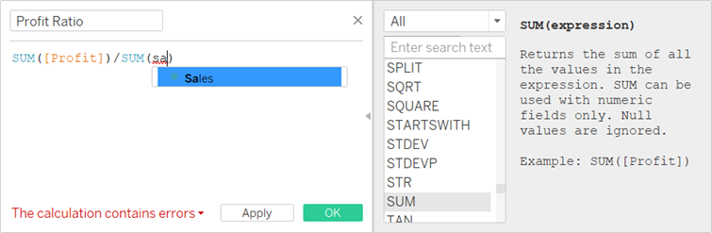
Creating and Editing Calculated Fields
Type directly on columns, rows, or the Marks card (ad-hoc calculations).
Use the Calculated Field editor (right-click in the data pane and choose Create Calculated Field).

Slide 68
Formula Editor Conventions
Color or Symbol | Description
Red squiggly line | Syntax error. Hover over the error to see directions to fix it.
//Gray Text | Comments. These are ignored by the calculation but are useful for documenting the calculation logic.
[Orange Text] | Field names.
Blue Text ( ) | Functions.
[Purple Text] | Parameters.
Bold Text | Calculation is computed locally within Tableau on the aggregated results.
Plain Text (not bold) | Calculation is computed at the database level.
ENTER, RETURN, SPACE and UPPER/lowercase (except for field names) are ignored.
Use " or ' for string fields

Slide 69
Types of Calculated Fields – Examples
Math operations across numbers
Addition or subtraction
Logic statements
IF/ELSE or CASE
Aggregating data
Average or maximum
Manipulating strings
Putting strings together or breaking them down
Date formulas
Pulling out a date part or the difference between two dates

Slide 70
Calculations and Aggregations
Aggregating in calculated fields can affect the formula’s order of operations:
Can therefore return different (and potentially incorrect) results.
Calculations occur in the data source.
Tableau will aggregate the results of individual transactions.
For example, when computing averages, you should apply an overall aggregate before computing ratios.
[Profit] / [Sales] is not the same as SUM([Profit]) / SUM([Sales])

Slide 71
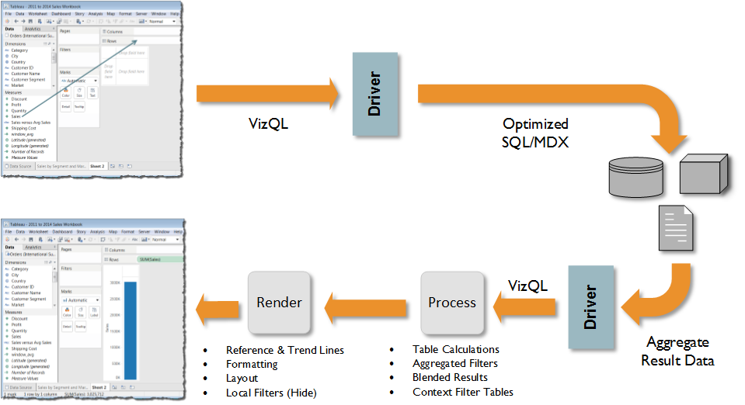
Desktop Architecture

Slide 72
Practice: Understanding Aggregations p. 20

Slide 73
String Functions
When using string fields, the plus sign (+) is the concatenation operator.
Spaces and additional text can be included, but should be in quotes (" ").
Example:
"First Name" + " Last Name"
(Note the extra space before the word Last.)

Slide 74
Type Conversions
In a formula, if a plus sign is used between a string and a numeric field, an error results:
A plus concatenates strings, but a plus is also used to perform addition on numbers.
The calculation engine isn't sure what to do.
Use a type conversion function to convert the number to a string:
"Customer Number " + STR([Customer Number]) + ", " + [Customer Name]
Note the use of extra spaces.
Resulting string output: Customer Number 10, Bob Spencer

Slide 75
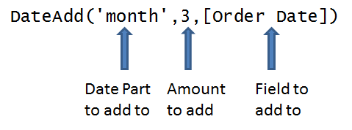
Date Calculations - Examples
DateDiff
Calculate a difference between dates.
DateAdd
Add some amount of time to an existing date field.
Date part calculations
Use year, month, day, hour, minute, or second.
DateParse
Change a string into a recognized date field.
Sometimes unavailable depending on the type of data connection being used.
DATEPARSE("MMMM,dd,yy","September,4,12") = 9/4/2012

Slide 76
Practice: Using Date Calculations p. 21

Slide 77
Split and Custom Split
Split regularly separated (delimited) strings in a column to create new columns.
Custom Split offers more control to split a column into multiple columns and to specify the separator used.
Split dimensions are calculated fields and have the same characteristics and limitations:
Are materialized in extracts,
Can be used for blends, but not for joins,
Not available for pivot/unpivot functionality.

Slide 78
Quick Table Calculations

Slide 79
Table Calculation Overview
Computations applied to the values for a measure in the view
Computed locally, after query results return, allowing for a second pass aggregation.
Table calculations have scope and direction:
Scope defines the area where the calculation is performed or defines each group for which the calculation is computed.
Direction specifies how the calculation moves through the area.

Slide 80
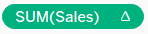
Using Quick Table Calculations
Predefined computations for data in your view
Utilize default direction for operation, such as "Table (across)"
A field used in a table calculation displays with an icon:
Examples:
Running total
Difference
Percent difference
Percent of total
Rank
Percentile
Moving average
YTD Total
Compound growth rate
Year over year growth
YTD Growth

Slide 81
Practice: Percent of Total p. 22

Slide 82
Reference Lines and Bands

Slide 83
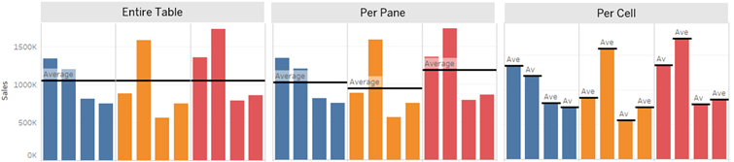
Using Reference Lines
Add reference lines to mark specific values or regions on an axis:
Example: average sales for a quarter or year
Based on constant or computed values.
Reference line scope can be the entire table, per pane, or per cell.

Slide 84
Reference Line Options
Values you can use as a reference line:
Average
Constant
Maximum/Minimum
Median
Sum
Total
Labels you can use:
None
Value
Computation
Custom
Tooltips you can use:
None
Value
Computation
Custom

Slide 85
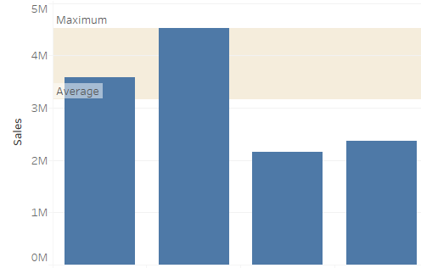
Reference Bands
Reference bands show data that falls within a certain window value:
Shown as shaded areas behind the marks on the axis.
Band between two constant or computed values.

Slide 86
Practice: Reference Lines and Bands p. 24

Slide 87
Showing Parts of a Whole

Slide 88
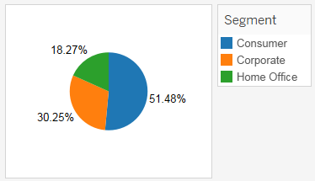
Pie Charts and Parts of the Whole
Helpful under the right circumstances:
Be aware of the limitations of our perceptual system; our perceptual system does not compare areas or angles accurately.
Limit the number of members and add labels to help your audience.
Pie charts are useful for:
Filtering or highlighting sections of a dashboard.
Showing high-level breakdown of a measure with a small number of members.

Slide 89
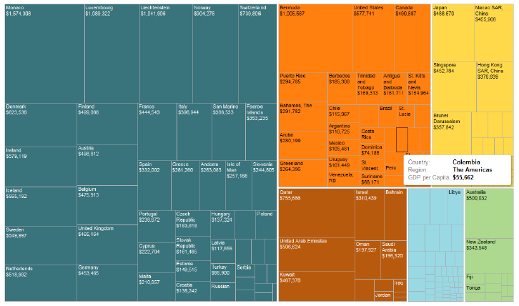
Creating Tree Maps
Use to show part-to-whole relationships at a glance:
Read from top left to bottom right.
Use color to differentiate categories.
Add labels to show number value.
Good for data sets with long tails.
Especially good for hierarchical, categorical data.
Can use a highlighter to search and compare data.

Slide 90
Practice: Pie Charts and Tree Maps p. 26

Slide 91
Parameters

Slide 92
Practice: Exploring Parameters p. 28

Slide 93
Mapping

Slide 94
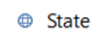
Mapping in Tableau
Create views using maps to show data distributions by geographic locations.
Fields in your data with geographic information display in the data pane with a globe icon. For example:
Latitude and longitude fields are automatically generated for many geographic information types.

Slide 95
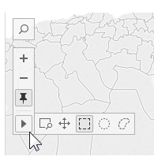
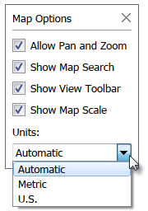
Navigation and Selection in Maps
Maps created in Tableau Desktop have several navigation, search, and selection options for user interaction:
Map Search
Zoom and Pan
Reset Axes
Zoom area
Pan
Rectangular selection
Radial selection
Lasso selection
Use Map Options to show or hide various options, or to choose map units.

Slide 96
Practice: Mapping Top North American Airports p. 31

Slide 97
Creating Geographic Groups
Create geographic groups using fields.
Examples: postal codes, counties, states
Use to show custom sales territories or to explore data regionally.
Create by visually grouping locations or by using the data pane.
Groups of groups (nested groups) can also be created.
Examples: hierarchical territories or divisions

Slide 98
Practice: Creating Geographic Groups p. 29

Slide 99
Dashboards

Slide 100
What is a dashboard?
A dashboard is a visual display of the most important information needed to achieve one or more objectives; consolidated and arranged on a single screen so that the information can be monitored at a glance.
- Stephen Few

Slide 101
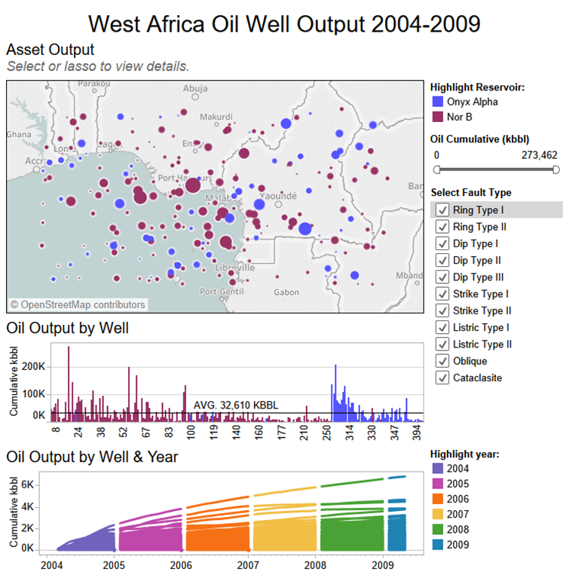
Dashboards
Show a collection of worksheets and supporting information in a single window.
Use to compare and monitor a variety of data simultaneously.

Slide 102
Relation between Dashboards and Worksheets
Views in a dashboard are connected to the worksheets they represent:
Changes to the worksheet update the dashboard.
Changes to the dashboard affect the worksheet.
From the dashboard, you can:
Go to a sheet.
Hide a sheet.

Slide 103
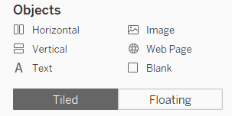
Tiled or Floating Objects
Tiled objects:
Arranged in a grid.
Can change how positioned or distributed within layout container.
Floating objects
Can be layered on top of other objects.
Make the selection in the dashboard window before the sheet is selected.
Floating objects can be reordered and resized.
Shift+drag to change an object from tiled to floating.

Slide 104
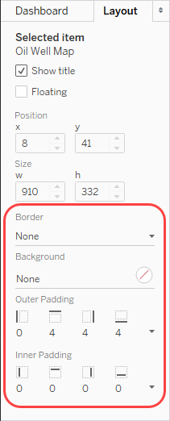
Formatting Components
Objects on a dashboard can be formatted in the following ways:
Adding a border
Adding a background color
Setting the inner and outer padding

Slide 105
Dashboard Device Layouts
Create layouts specific to particular device types, and optionally different models:
Desktop
Tablet
Phone
Hierarchical relationship—default dashboard is parent and device specific layouts are children:
Tailor composition and contents according to different browser window sizes.
Allow users to experience a dashboard expressly designed for their screen display.
Create and maintain only a single parent dashboard.

Slide 106
Practice: Creating a Dashboard p. 33

Slide 107
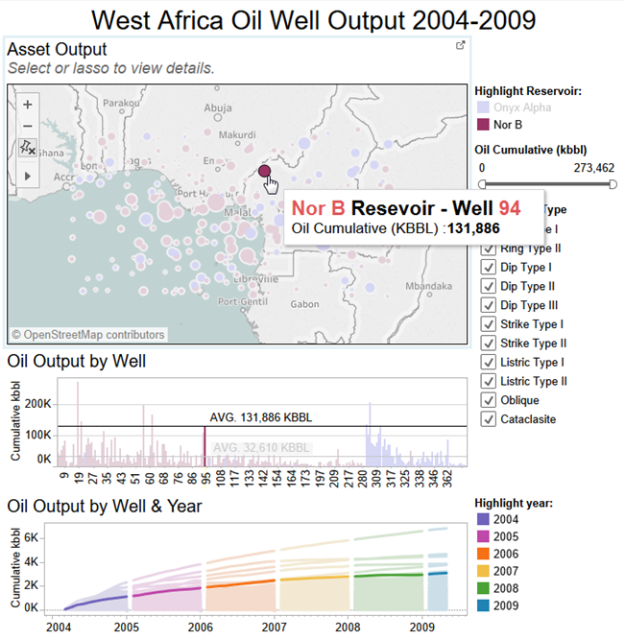
Dashboard Actions: Highlight
Actions add context and interactivity to your data.
Use highlights to call attention to marks of interest.
Use color to highlight select marks and to dim all others.
Allow user to select marks in the view or to click on the legend.

Slide 108
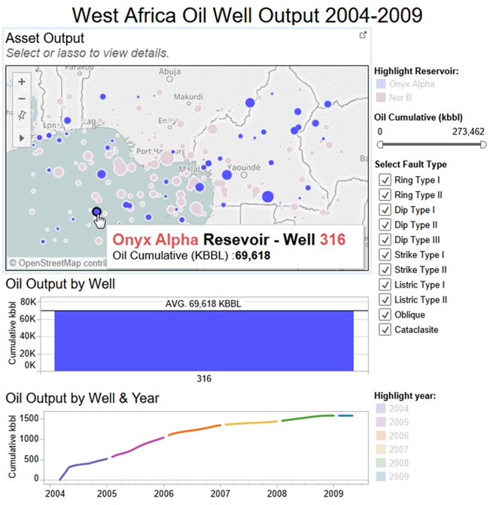
Dashboard Actions: Filter
Use to send information between worksheets:
Example: selecting a mark on one worksheet filters data on related worksheets to show only data related to the selected item.

Slide 109
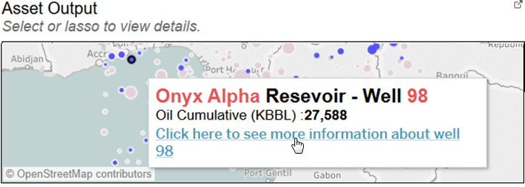
Dashboard Actions: URL
Include a hyperlink that points to a webpage, file, or other web-based resource outside of Tableau.
To make the link relevant to your data, add field values of a selection into the URL as parameters.

Slide 110
Additional Dashboard Actions
Action | Used to
Go to Sheet | Navigate from one sheet or dashboard to another.
Change Set Values | Change the values in a set when a user interacts with marks in a view.
Change Parameter | Change the values in a parameter when a user interacts with marks in a view.

Slide 111
Options for Running Dashboard Actions
For this field | Action | Works well for
Hover | Rest the pointer over a mark in the view to run the action. | Highlighting and filtering actions within a dashboard
Select | Click on a mark in the view to run the action. | All types of actions
Menu | Click a mark in the view and then select an option on the tooltip context menu. | Filter and URL actions

Slide 112
Practice: Adding Dashboard Actions p. 35

Slide 113
Publishing Online

Slide 114
Publish Your Work to Share with Others
Tableau Online
Tableau Server
Tableau Public

Slide 115
Misc

Slide 116
Order of Operations (Query Pipeline)
Extract Filters
Data Source Filters
Context Filters
Sets, conditional filters, top N, Fixed LOD
Dimension Filters
Include/Exclude LOD, data blending, simple aggregations
Measure Filters
Forecasts, table calcs, clusters, totals
Table Calc Filters
Trend lines, pages,
reference lines

Slide 117
General Resources
Support
Desktop - tableau.com/products/desktop
Learning Paths – tableau.com/learn/learning-paths
Classroom – tableau.com/learn/classroom
Whitepapers – tableau.com/learn/whitepapers
Blueprint – tableau.com/blueprint
Visual Gallery – tableau.com/solutions/gallery
Knowledge Base – kb.tableau.com
Tableau Public – public.tableau.com/s/
Online Help – tableau.com/support/consulting, tableau.com/support/help, tableau.com/support/knowledgebase
Calculations: https://community.tableau.com/community/viz-talk/tableau-community-library/twl
Community
community.tableau.com/welcome
Twitter
Blogs
Tableau User Groups
Makeover Monday/Workout Wednesday
Tableau Conference
https://tc19.tableau.com/learn/sessions/

Slide 118
Become a Certified Tableau Expert
Build your resume, advance your career, and showcase your Tableau skills through the Tableau Product Certification Program.
Becoming certified is an excellent step to validate your hard-earned Tableau knowledge and experience. The program offers two levels of certification for both Desktop and Server.
For more information or to register for an exam, go to tableau.com/support/certification

Slide 119

Desktop Certifications
Foundational functionality and product comprehension | Comprehensive functionality and product expertise | Advanced functionality and application of visual best practices

Slide 120

Server Certifications
Administrative functionality and platform knowledge | Architectural knowledge and platform integration expertise

